Slide 1

Image Captioning
CSE 499A Project
Group Members
Shahil Azmayish
1721552042
Zahidul Islam
1721957642

Slide 2
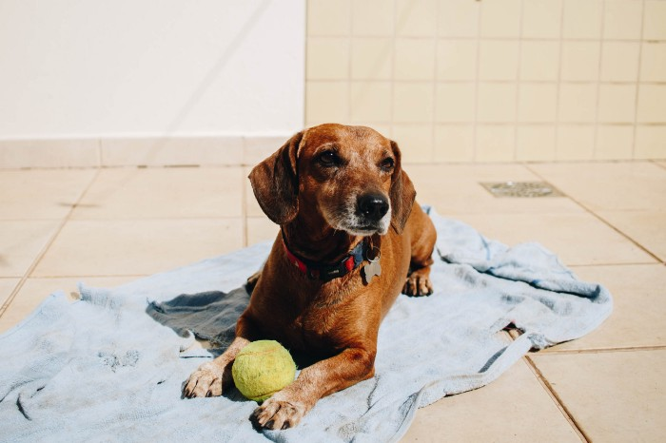
“A puppy on a blue towel” or “ A brown dog playing with a green ball”
Image captioning. It is the process of generating textual description from an image.
The first part is handled by CNNs and the second is handled by RNNs.

Slide 3

Related works
• This problem was well researched by Andrej Karapathy in his PhD thesis at Stanford, who is also now the Director of AI at Tesla.
• To get a better feel of this problem, I strongly recommend to use this state-of-the-art system created by Microsoft called as Caption Bot. Just go to this link and try uploading any picture you want; this system will generate a caption for it.
Motivation
Aid to the blind
Self driving cars
In web development
Automatic Captioning can help, make Google Image Search better
CCTV Cameras

Slide 4
Course Overview
Collaboration:
Since CSE299
Meeting Time
Problems
Collaboration
Who did what

Slide 5
What part of the project is the most Original
Developing Deep Learning Model -> Google Colab
Dataset: Flicker8K
Check for some data quality.
Format data to make it consistent.
Reducing data & Decompose data.
Train With Progressive Loading (NEW)
Generate New Captions
Evaluate Model
Future Plan
Bangla Image Captioning
We are working on our own Dataset
Dataset: Dhaka2k21 (2k Images)
Preparing Photo Data
Preparing Text Data

Slide 6
Design Approach
Model
RNN/LSTM
Type of non-linearity (sigmoid, tanh, RELU, etc)
Feed image to RNN on every step/once
Random initialization/pretrained models
Models: RNN + CNN
How to combine image and and sentence?
RNN + CNN:
Encoder-decoder model
Multimodal layer

Slide 7
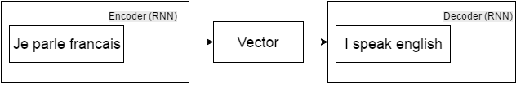
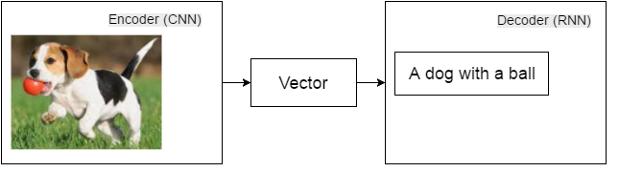
Encoder-decoder model: machine translation
Encoder-decoder model: image caption

Slide 8
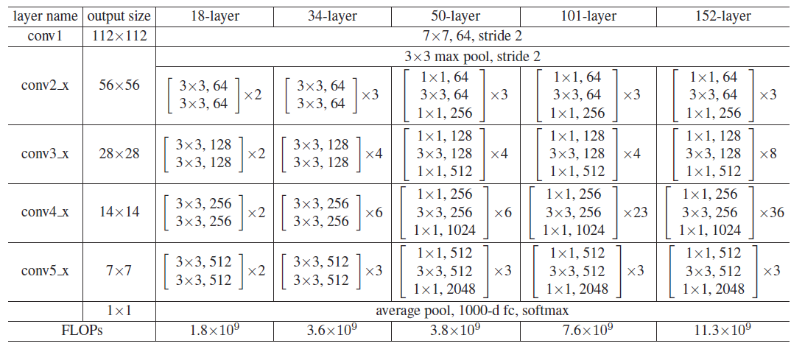
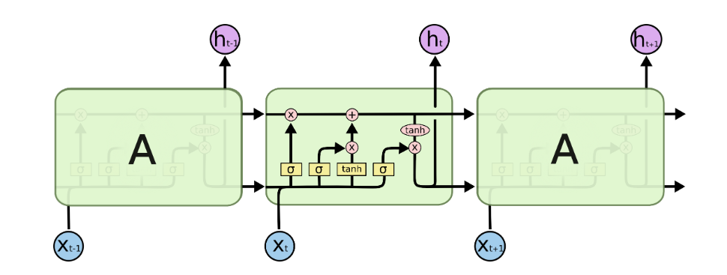
EncoderCNN
Extract feature vector from input image
Based on pretrained ResNet50
Only require very small modifies
DecoderRNN
LSTM: Long Short Term Memory networks
Multiple Copies of the same network
Contained three gates to control the cell state
Capable of learning long-term dependencies.

Slide 9






Tools
Dense
Flatten
Convolution2D
Dropout
LSTM
TimeDistributed
Embedding, Bidirectional
Activation
RepeatVector
Concatenate
pretrained Convolutional neural network - ResNet50

Slide 10
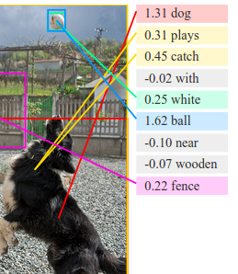
Results analysis
Pretrain RegionCNN for object regions (instead of images)
Detect top 19 regions (bounding boxes)
Sentence-image score
Accurecy ->
Multiple references for one image (usually 5)
Still not enough diversity
Not a lot of data

